Slide 1

Kapil Gautam KXG180032 Spring mass-damper cloth
CS6323.001 - Computer Animation & Gaming Final Project

Slide 2
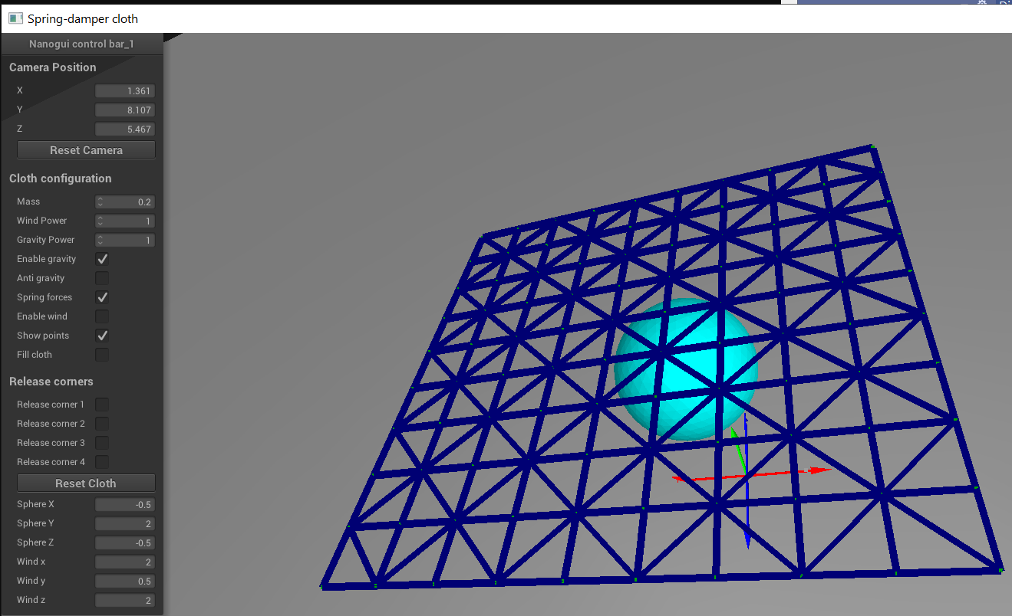
Spring Mesh
10x10
Using Edge, Diagonal and Angle springs between points.

Slide 3
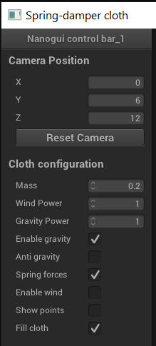
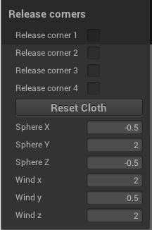
Multiple control points
Mass
Gravity
Wind
Anti-gravity
Show points, fill cloth
Release any corner
Configurable Sphere and wind positions

Slide 4
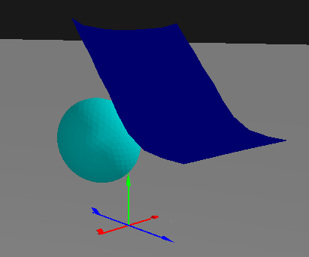
Cloth when one and two corners are released

Slide 5
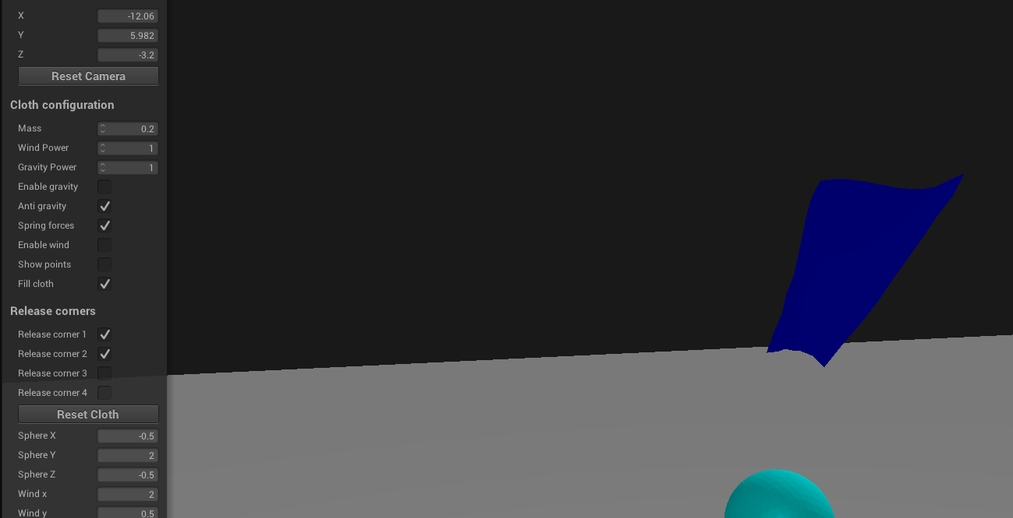
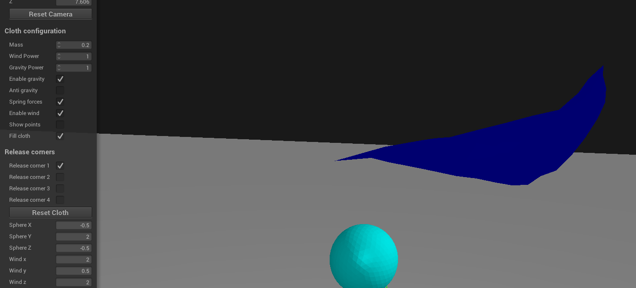
Applying anti-gravity
Applying Wind

Slide 6
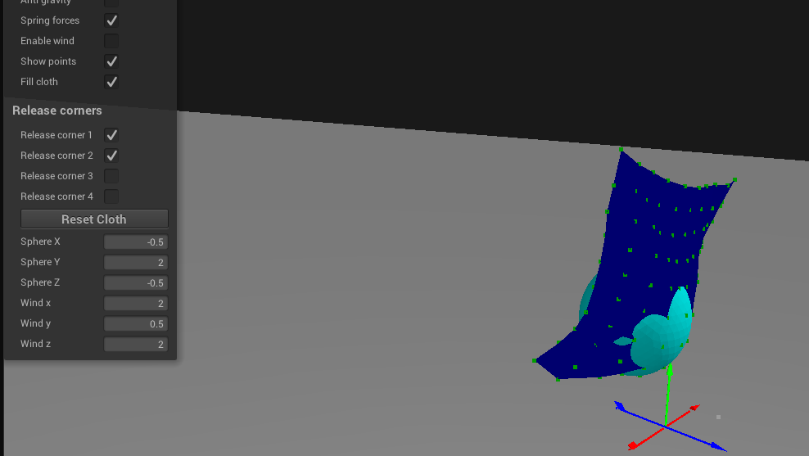
Cloth-sphere collision

